Slide 1
Modeling radiation belt electrons with information theory and neural networks
Simon Wing¹ and Jay Johnson²
¹The Johns Hopkins University Applied Physics Lab
²Andrews University
Acknowledgements: Drew Turner, Sasha Ukhorskiy, Romina Nikoukar, Tom Sotirelis, Giuseppe Romeo, and Alexander Boyd

Slide 2
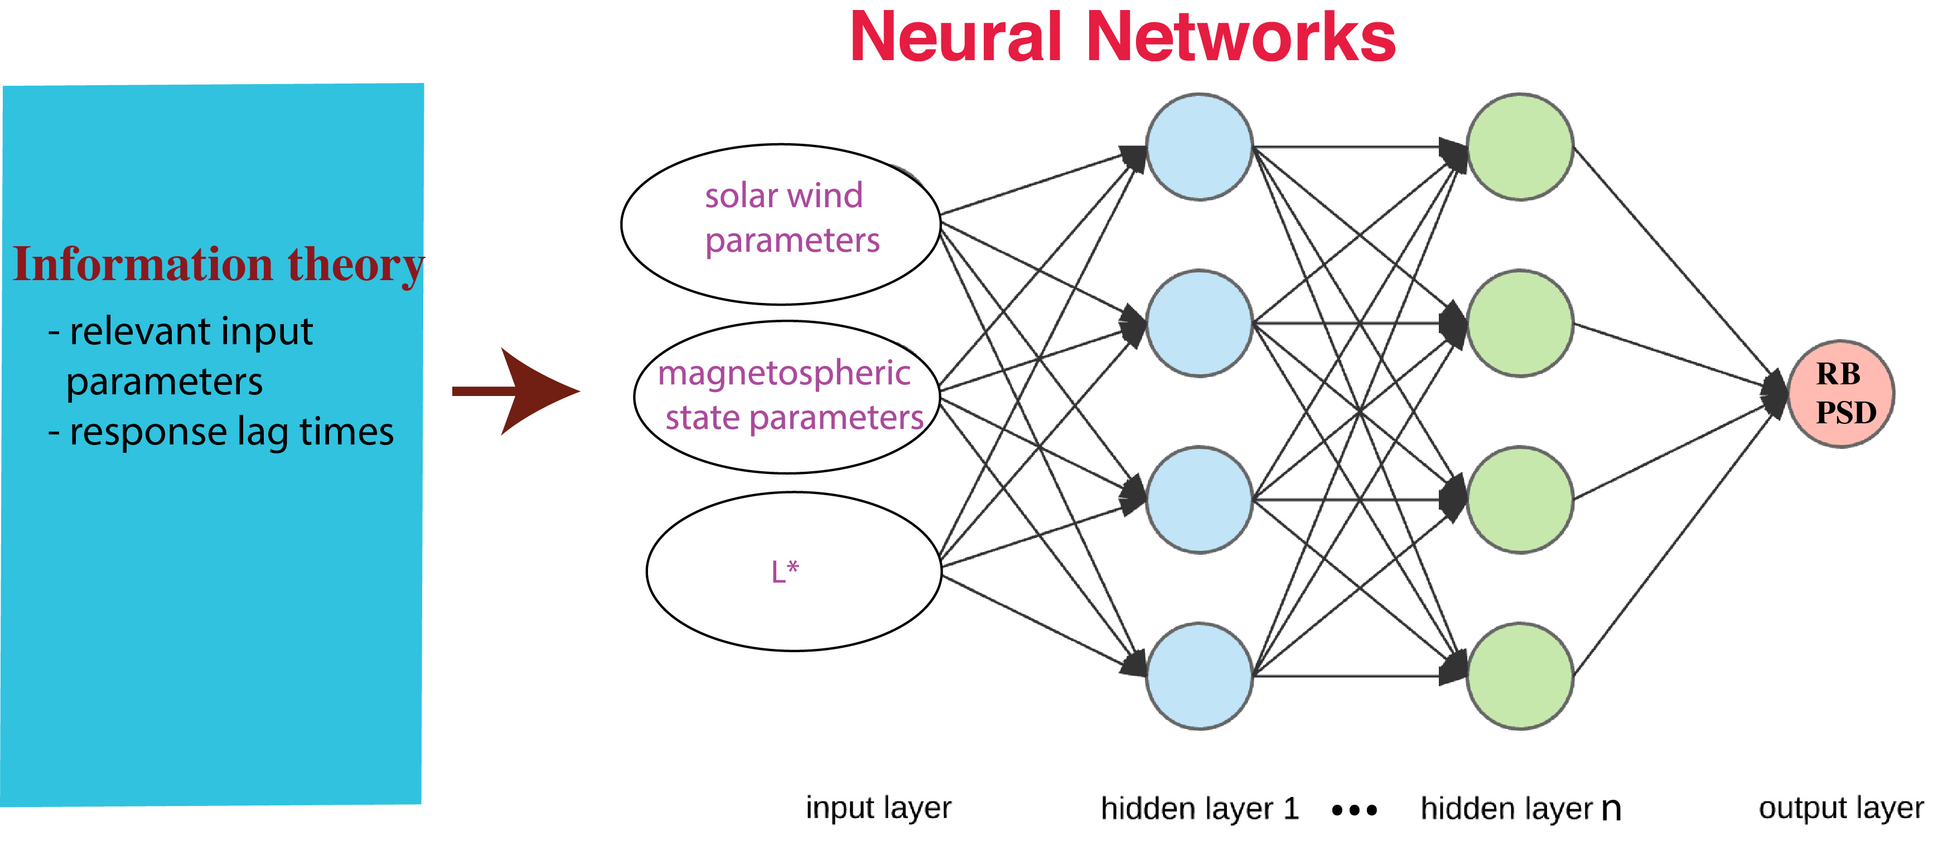
use information theory and NN to model RB electron PSD

Slide 3
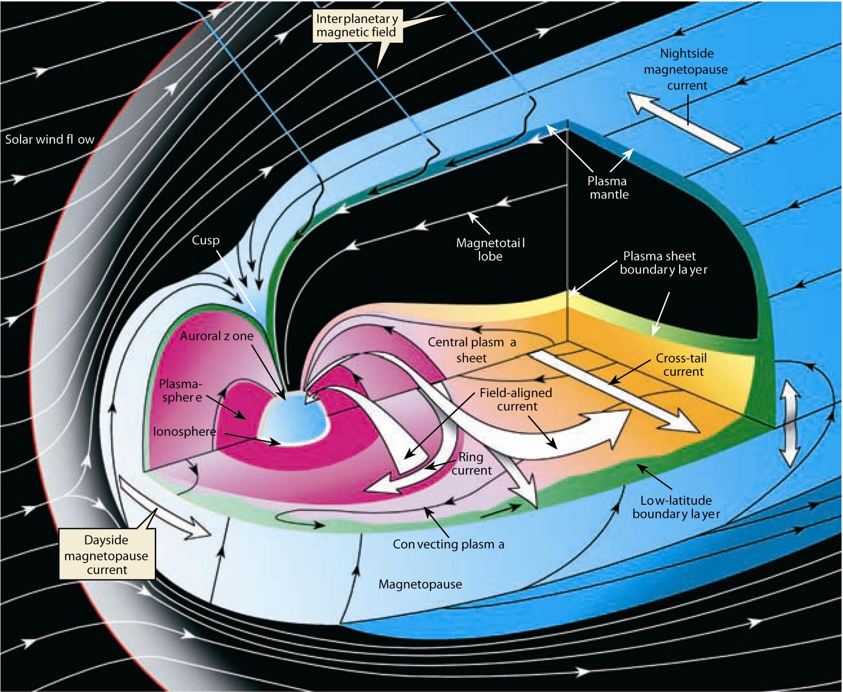
Magnetosphere
the radiation belts

Slide 4
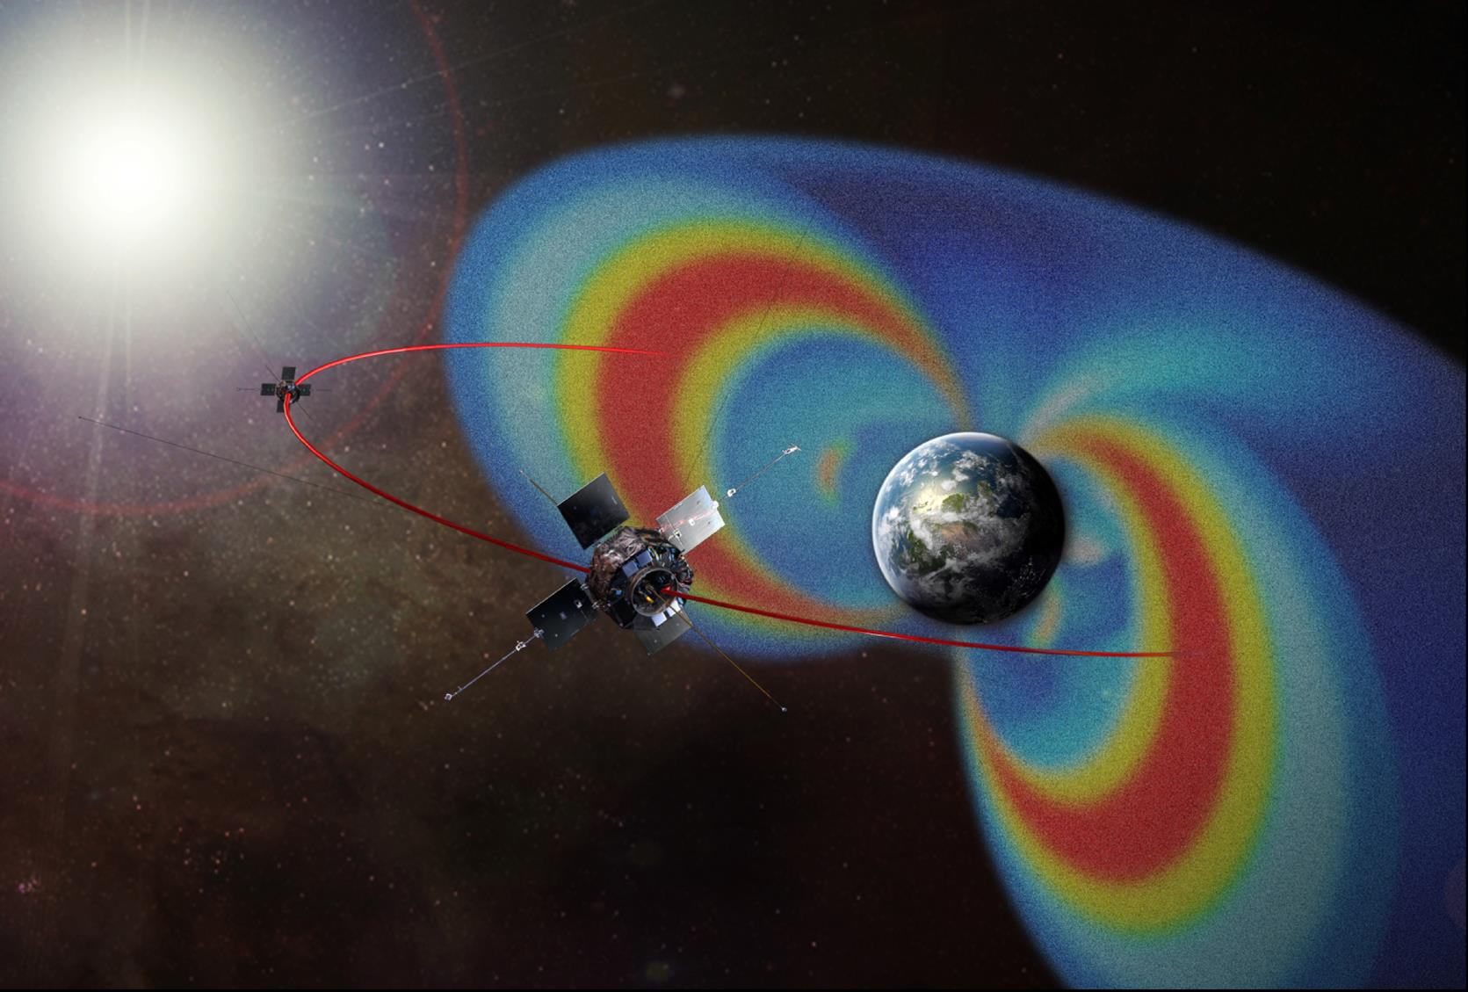
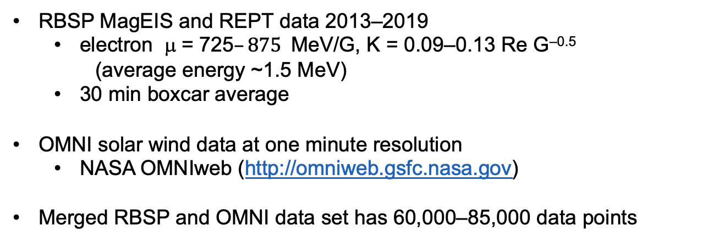
Data set
RBSP MagEIS and REPT data 2013–2019
electron μ = 725$–875$MeV/G, K = 0.09–0.13 Re G^{–0.5}
(average energy ~1.5 MeV)
30 min boxcar average
OMNI solar wind data at one minute resolution
NASA OMNIweb (http://omniweb.gsfc.nasa.gov)
Merged RBSP and OMNI data set has 60,000–85,000 data points

Slide 5
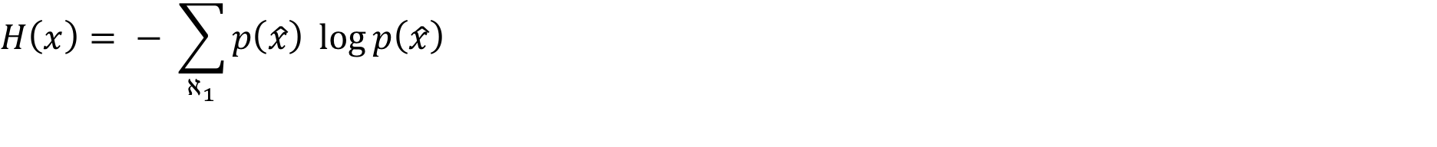

Methodology
mutual information (MI) [Tsonis, 2001]
conditional mutual information (CMI) [Wyner, 1978]
MI (x, y) = H (x) + H (y) − H (x, y)
MI identifies nonlinear dependence between two variables
CMI(x, y | z) determines the mutual information between x and y given that z is known

Slide 6
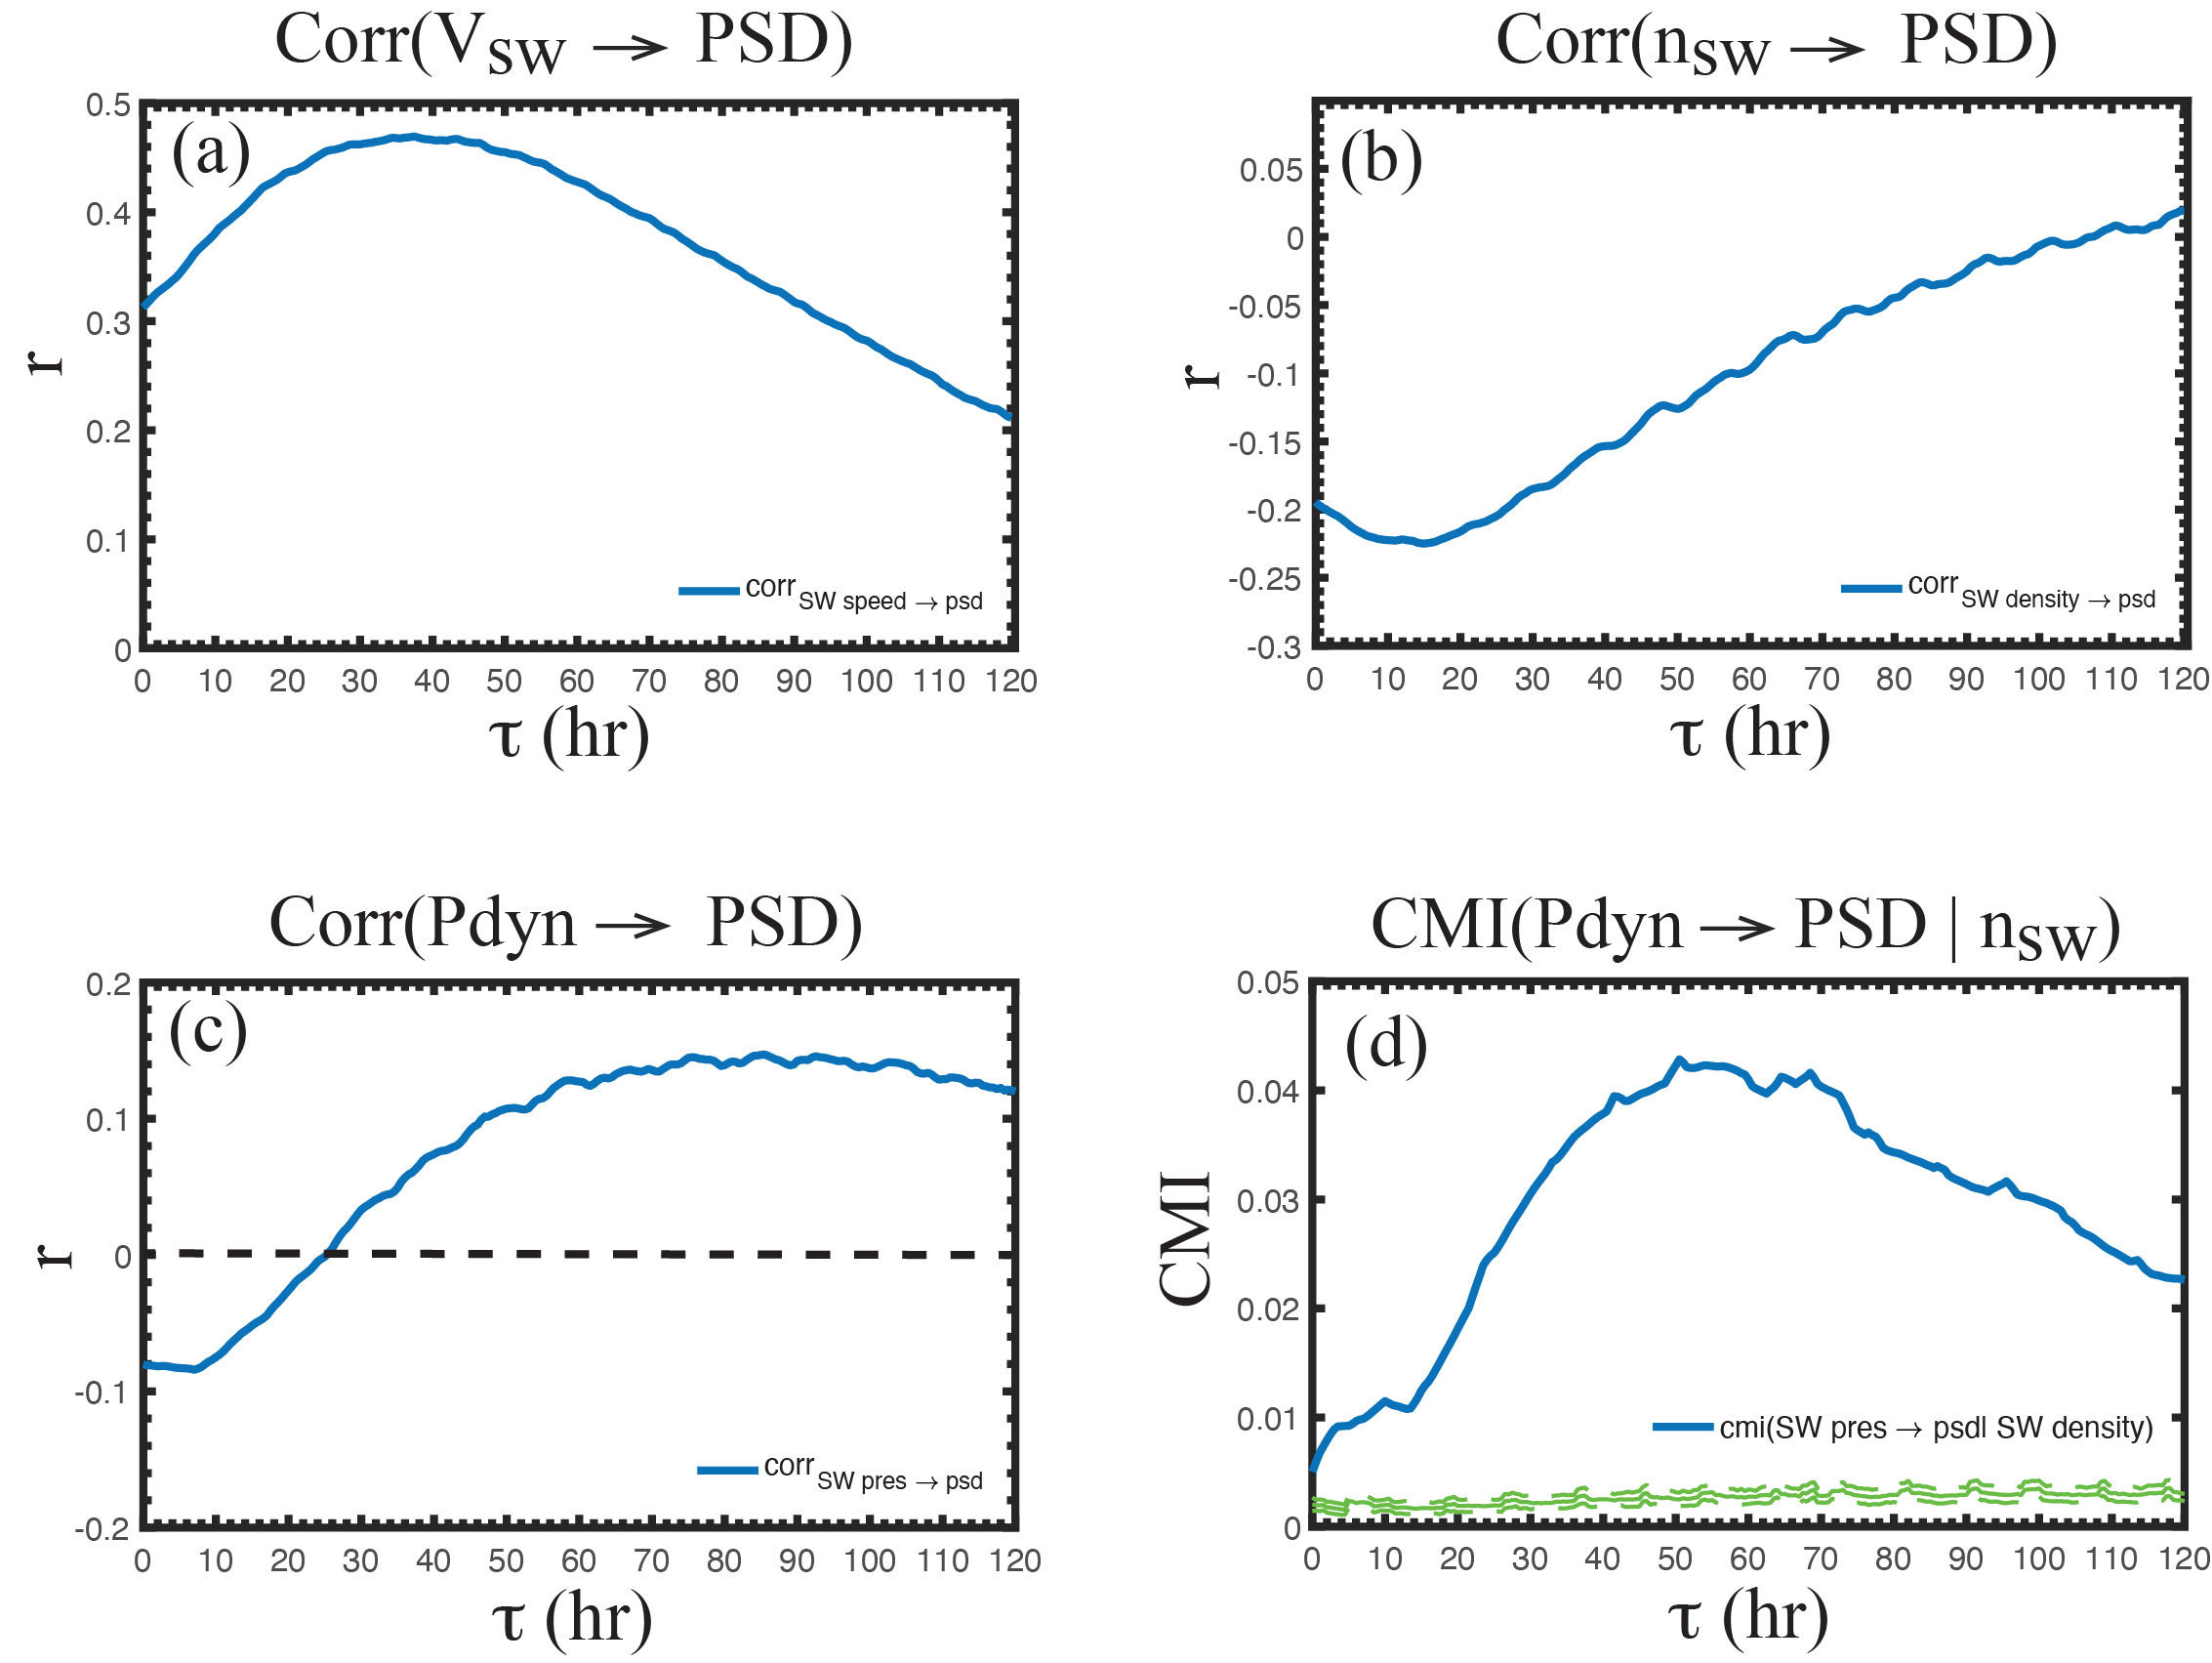
An example of CMI: RB electron response to Vsw, nsw, and solar wind pdyn
corr(Vsw(t), psd(t + τ))
corr(nsw(t), psd(t + τ))
CMI(pdyn(t), psd(t+τ)| nsw(t))
corr(pdyn(t), psd(t + τ))

Slide 7
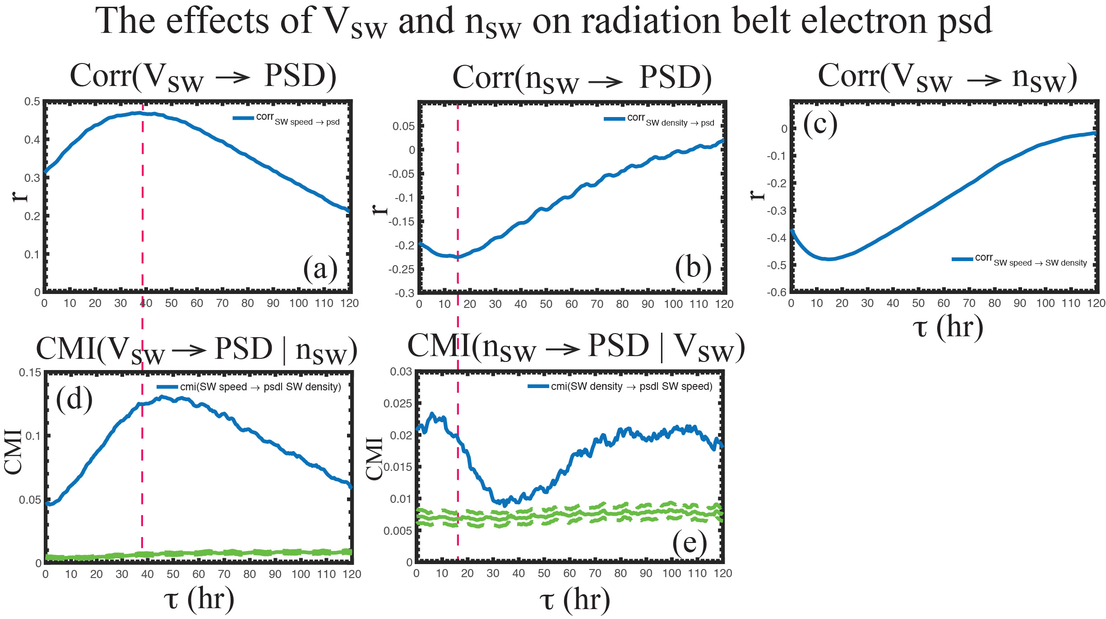
electron response peaks ~46 hr
electron response peaks at 7-11 hr

Slide 8
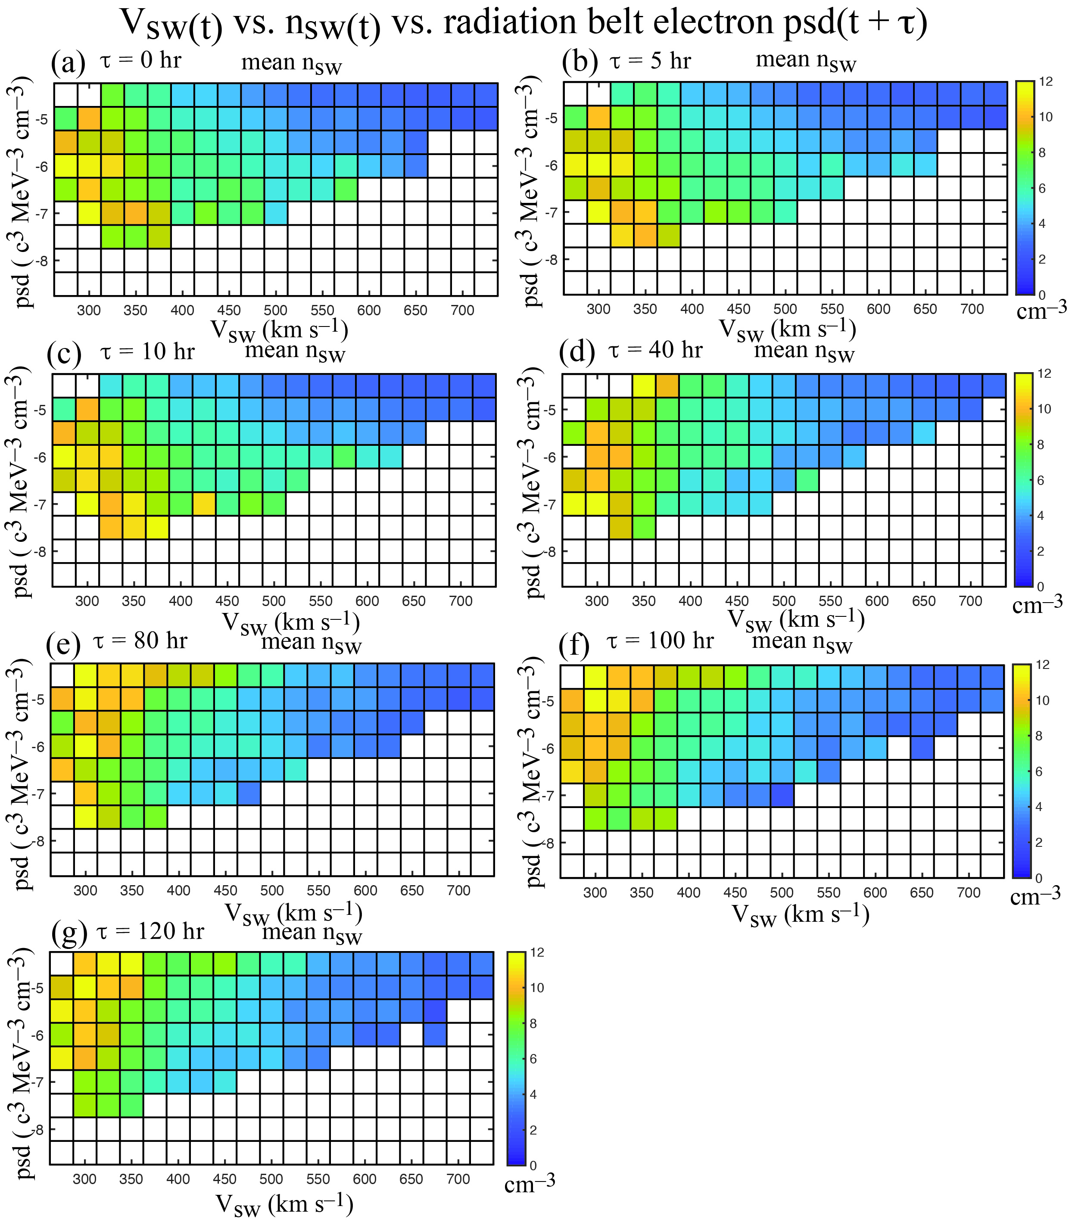
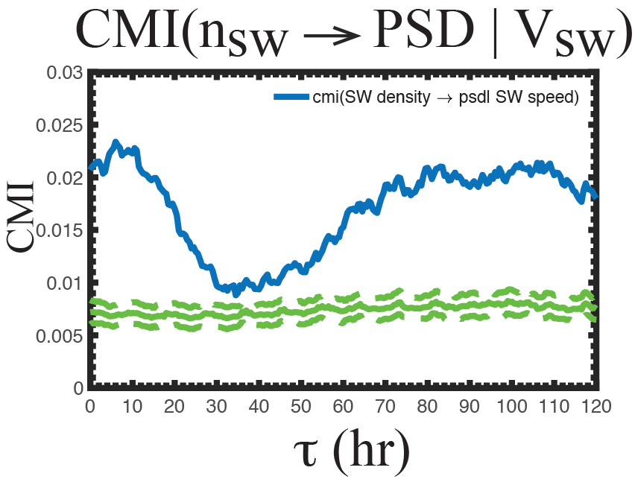

Slide 9
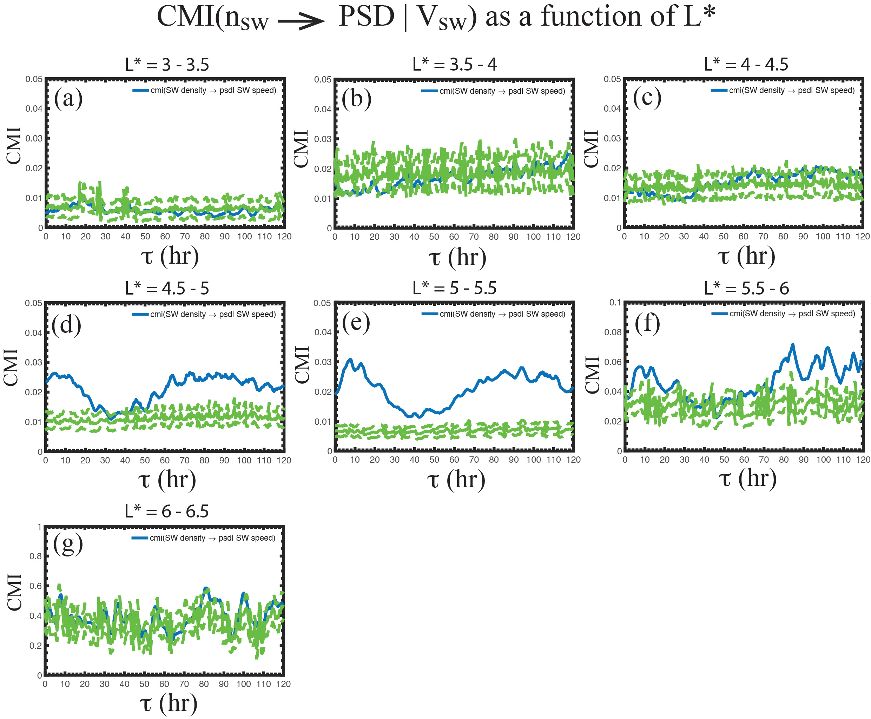
Radial dependence of RB electron PSD on n_{sw}
The effect of n_{sw} is not significant at L* < 4.5
higher noise/variability

Slide 10
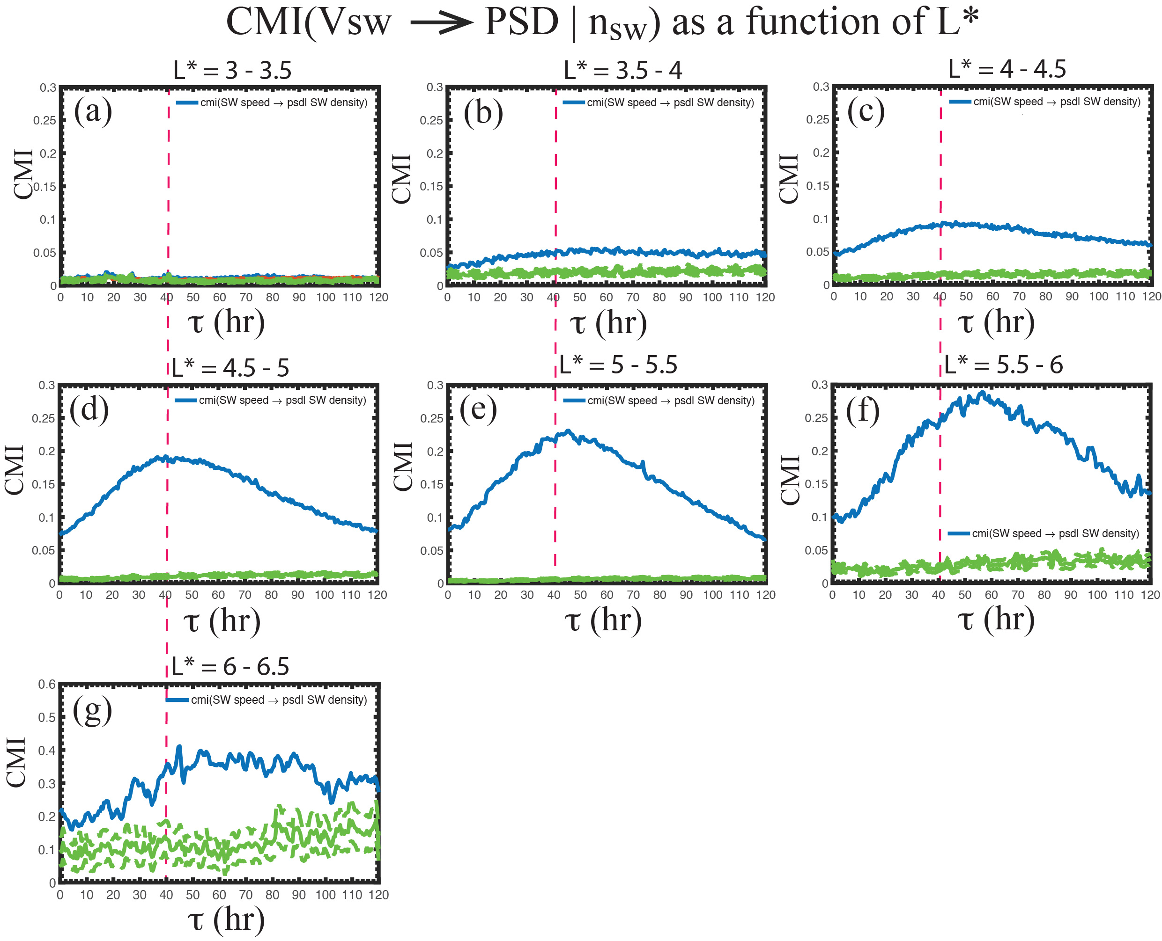
Radial dependence of RB electron PSD on V_{sw}
The effect of V_{sw} is not significant at L* < 3.5

Slide 11
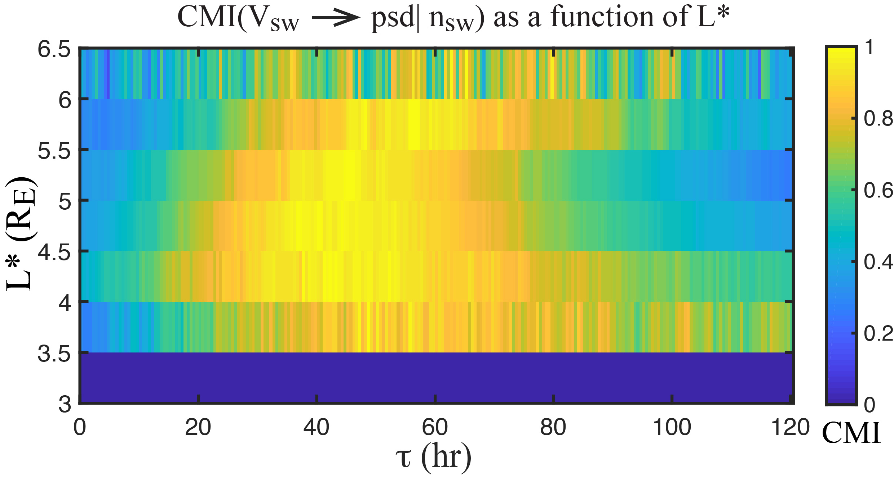
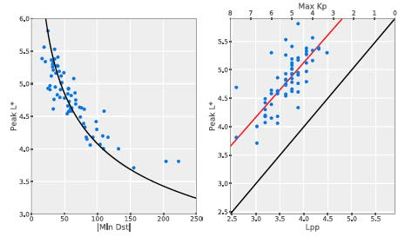
Local acceleration and radial diffusion
Boyd et al., 2018
locations of local acceleration

Slide 12
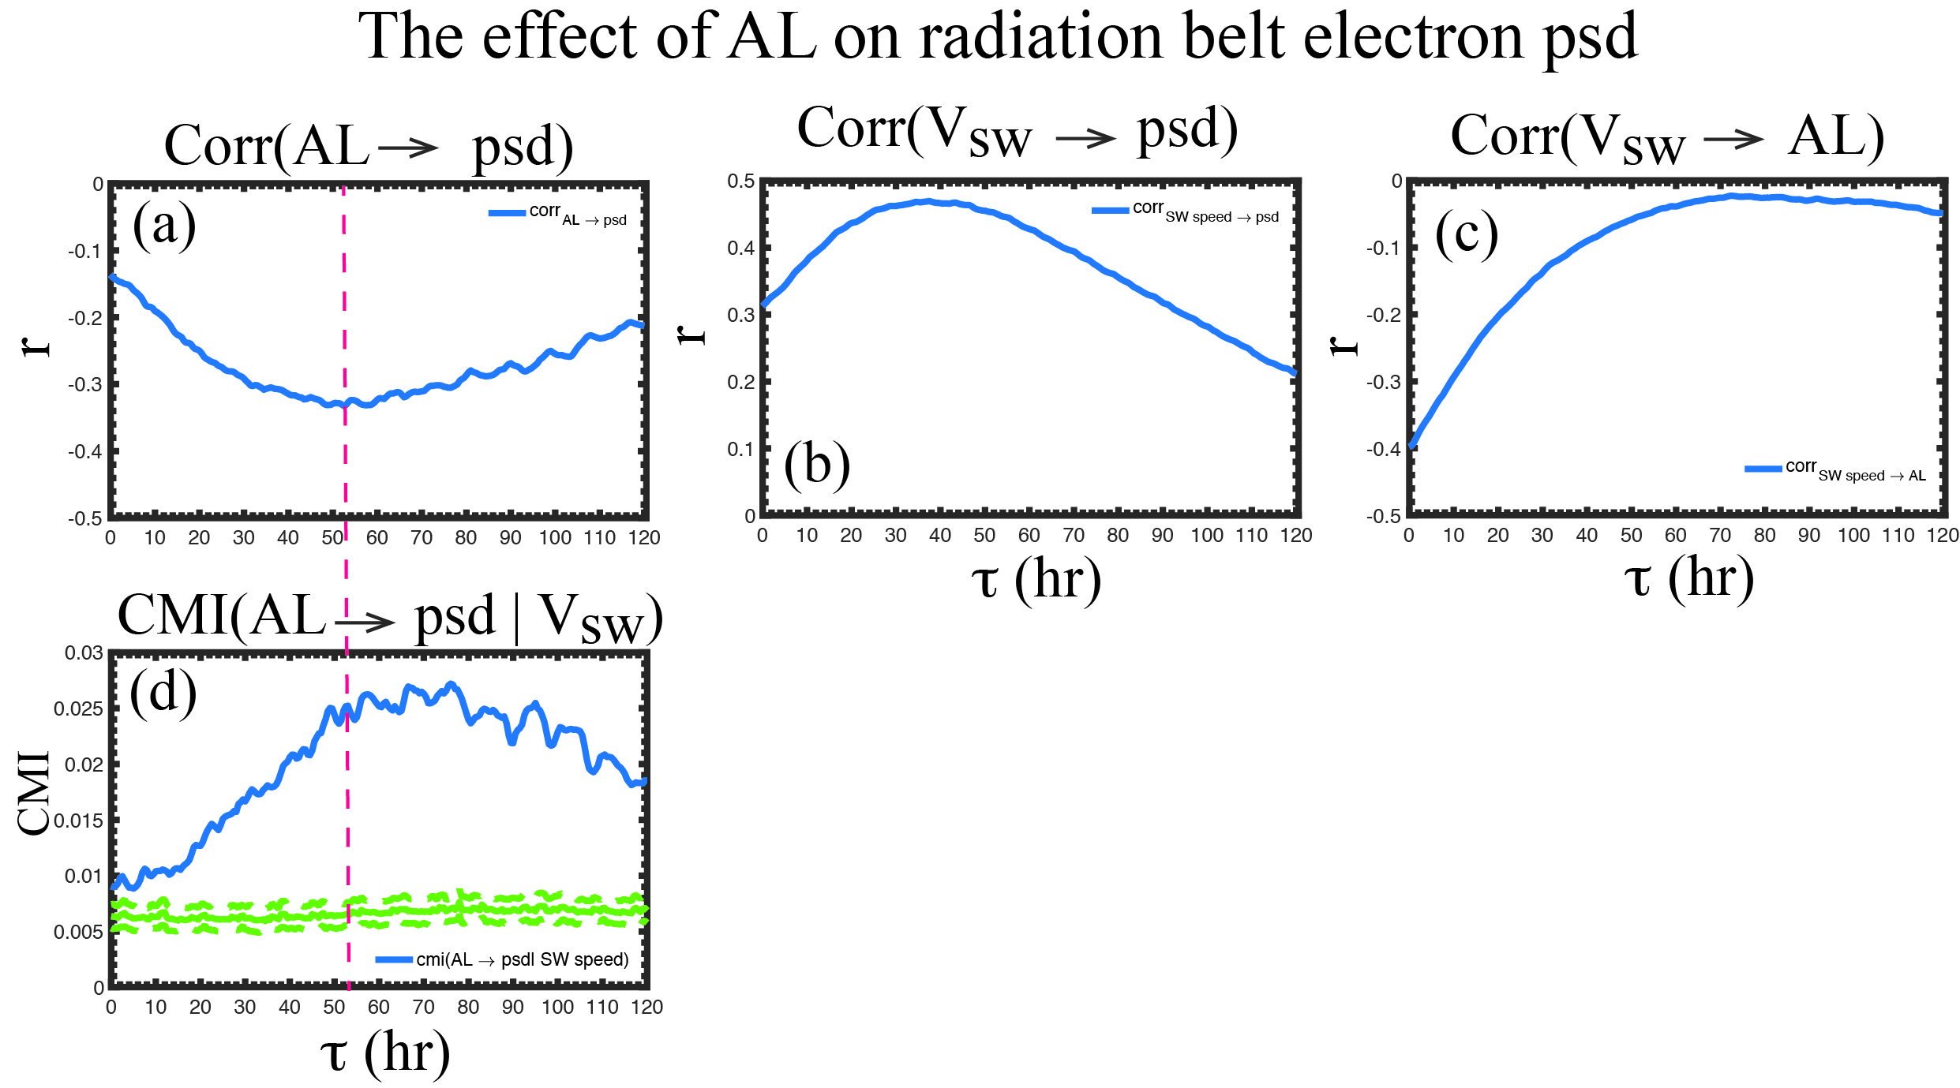
How much additional information does AL provide to RB PSD, given Vsw?
corr(AL(t), psd(t + τ))
How much additional information does AL provide to PSD?
there is information transfer from AL to PSD even with the effect of Vsw removed
the cmi peaks at τ ~50–80 hour

Slide 13
solar wind and magnetospheric parameters ranked by information transfer to PSD given Vsw
rank | solar wind and magnetospheric parameters | peak CMI (i_{tr_max}) | peak τ (hour)
1 | Vsw | 0.12 | 44–56
2 | SYM-H | 0.030 | 20–70
3 | AL | 0.020 | 50–80
4 | Pdynª | 0.018 | 7–11
5 | IMF |B|ª | 0.018 | 60–110
6 | IMF Bz < 0ª | 0.017 | 60–110
7 | nswª | 0.016 | 7–11
8 | IMF Byª | 0.012 | 0–12
9 | Esw | 0.012 | 40–90
10 | IMF Bz > 0 | 0.011 | 0–12
11 | σ(IMF B) | 0.0083 | 0–12
ª = the response has dual mode: at small τ (τ < 15 hr) the response is electron loss and at large τ (τ > 40 hr) the response is electron enhancement. The ranking is based on the larger peak of the two responses.

Slide 14
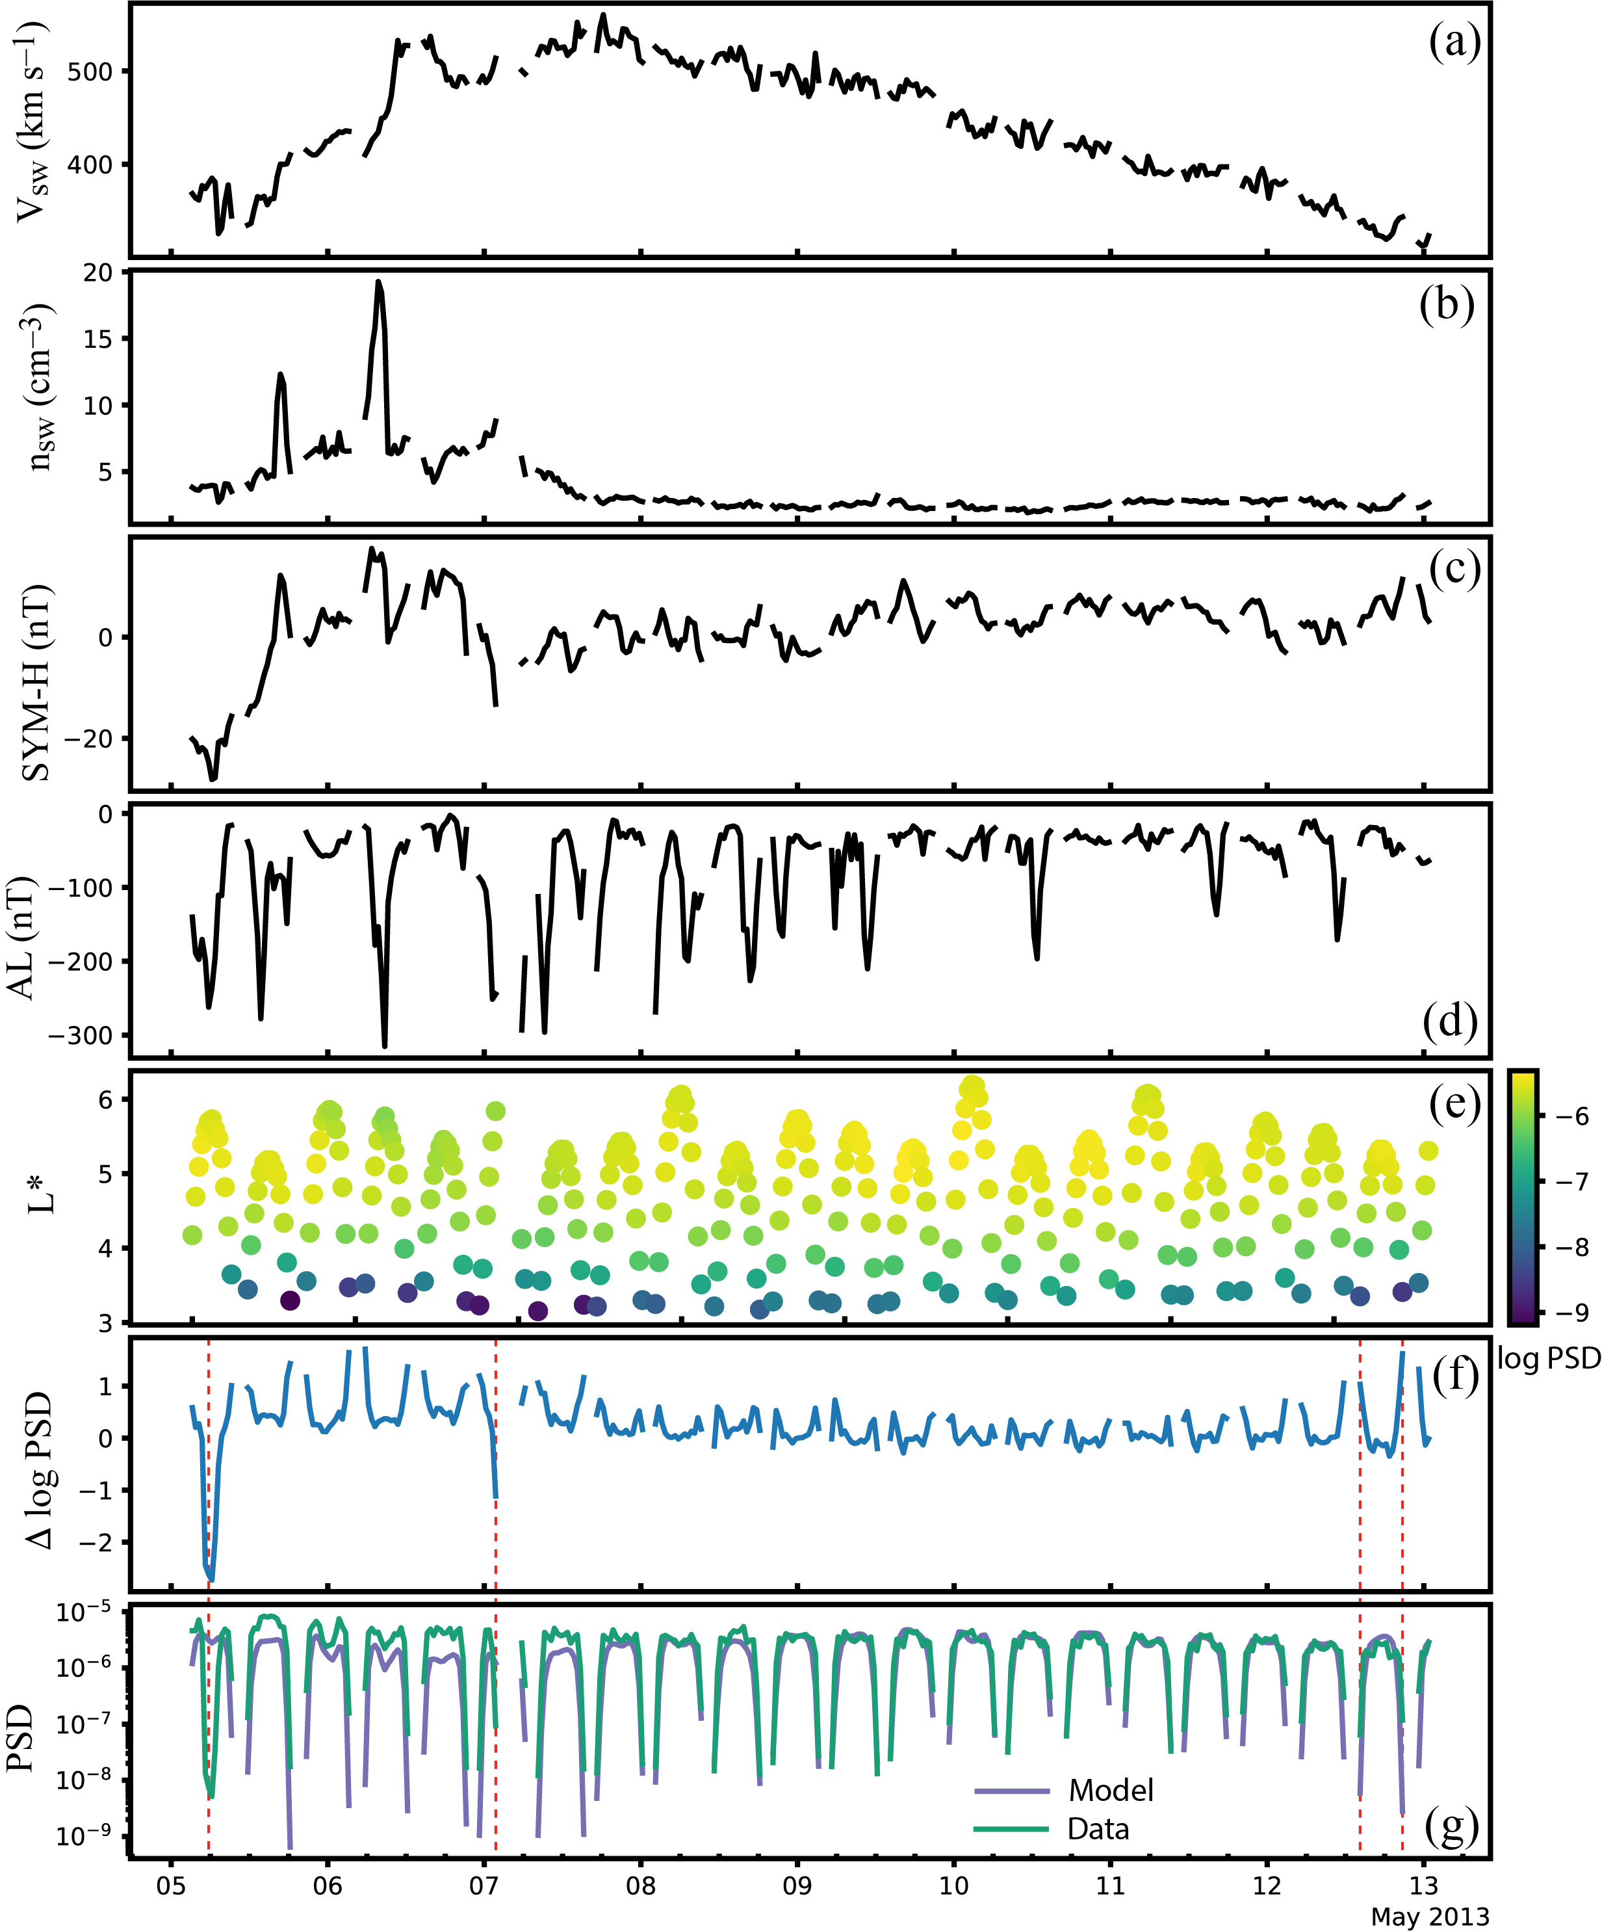
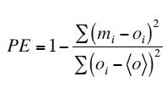
Baseline model
data: RBSP 2013-2018, μ = 525–875 MeV/G, I = 0.083–0.14 Re G^{0.5}, average energy = 1.3 MeV
 | Input parameters | Output parameter
1 | Vsw(t) to Vsw(t–72 hr) | PSD (t)
2 | nsw(t) to nsw(t–12 hr)
3 | IMF |B(t)| to |B(t–10 hr)|
4 | IMF Bz(t) to Bz(t–10 hr)
5 | IMF By(t) to By(t–10 hr)
6 | SYM-H(t) to SYM-H(t–72 hr)
7 | AL(t) to AL(t–72 hr)
PSD ranges from 10^{–11} to 10^{–5} c³ cm^{–3} MeV^{–3}
RMSE: 3.1 x 10^{–6} c³ cm^{–3} MeV^{–3}
MAPE: 115%
Median APE: 57%
PE: 0.62

Slide 15
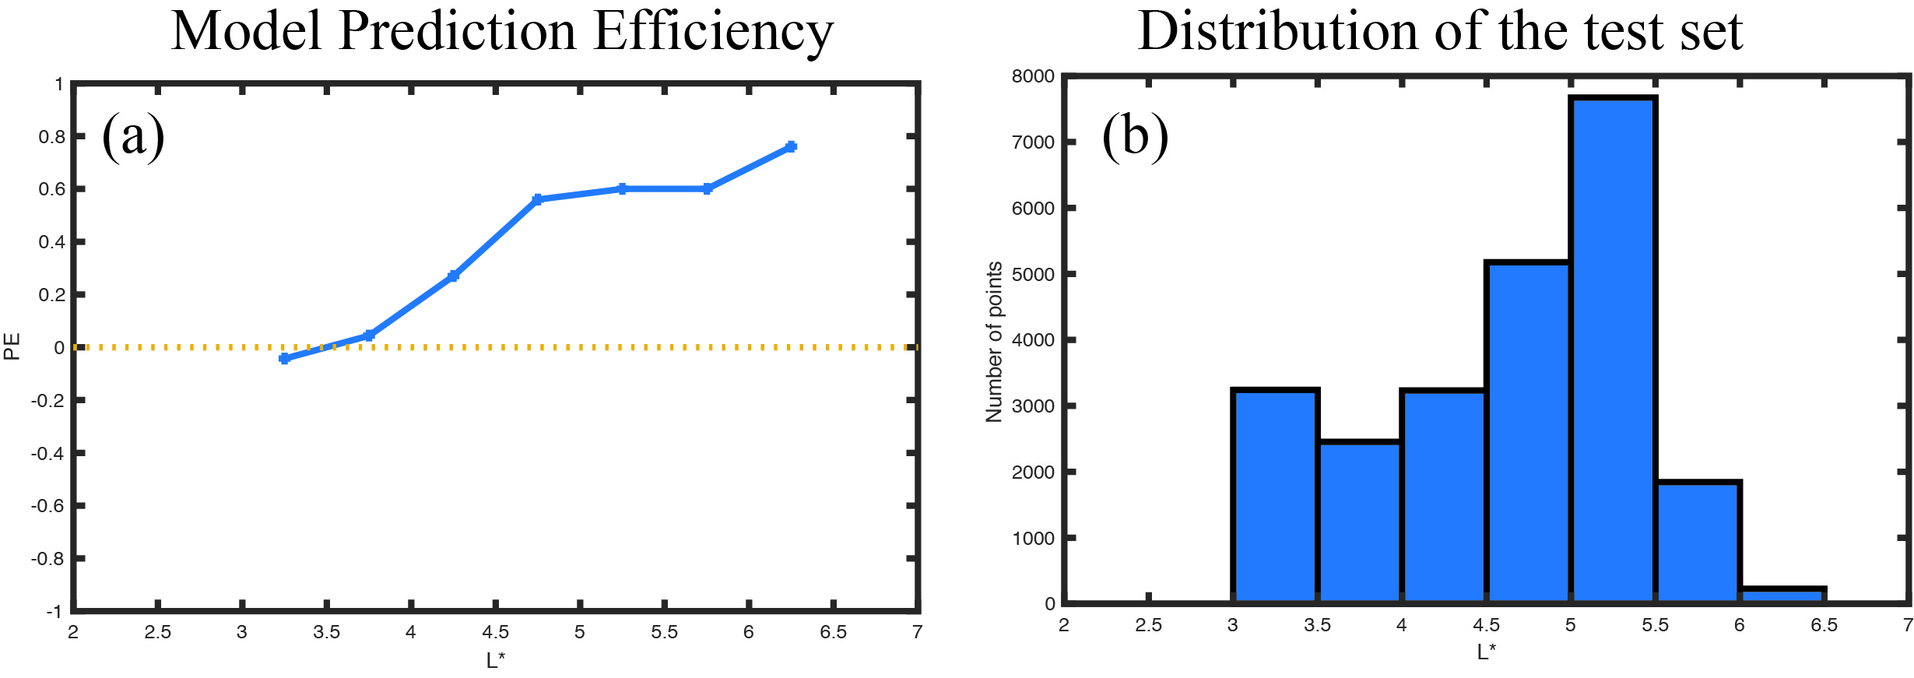
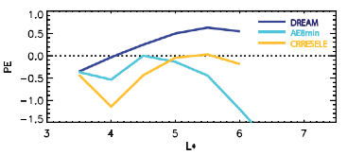
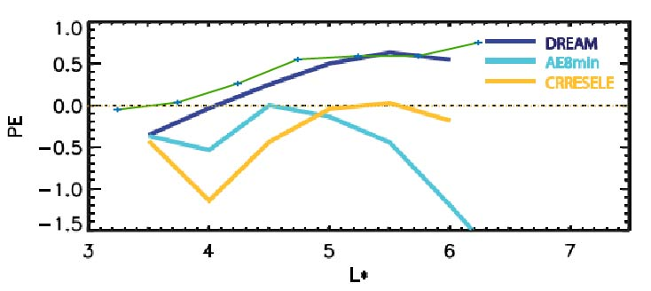
Reeves et al (2012)

Slide 16
The importance of SYM-H and AL in predicting RB PSD
without AL and SYM-H as input parameters

Slide 17
Summary
Information theory can help modeling by identifying
Relevant drivers of the radiation belt electrons
Response lag time
For ~1.5 MeV RB electrons (μ = 725–875 MeV/G, K = 0.09–0.13 Re G^{–0.5}):
V_{sw} does not affect PSD at L* < 3.5
n_{sw} does not affect PSD at L* < 4.5
AL and Sym-H provide additional information to RB electrons beyond what Vsw provides
CMI(V_{sw} → PSD| n_{sw}) suggests local acceleration at L* = 4-5.5 and inward/ outward diffusions
n_{sw} correlates with PSD at τ = 50–120 hr, which may suggest a new way to accelerate RB electrons
We rank solar wind and magnetospheric drivers of RB electrons based on CMI
We use NN(MLP) to model RB electron PSD
We plan to develop a more advanced model using LSTM

